Slide 1
Unify and Conquer Towards a Unified View of Machine Comprehension
Daniel Khashabi Allen Institute for AI, Seattle
Notes:
Hi everyone,
For those who don’t know me, I am Daniel Khashabi, and I am AI2 Seattle. Very happy to be chatting with you!
At this point it’s past midnight here, so in case at some point the voice is cut, it either the internet or it’s because I have fallen asleep.
Since the audience is NLP folks, going to be a bit technical; as in I will be using technical terms (dataset names, system names, etc). If anything confused you for whatever reason, if anything is unclear, please stop me.
My goal is to keep it shorter than usual talks, knowing long online talks are not as fun.
## An alternate name is: unite and conquer

Slide 2

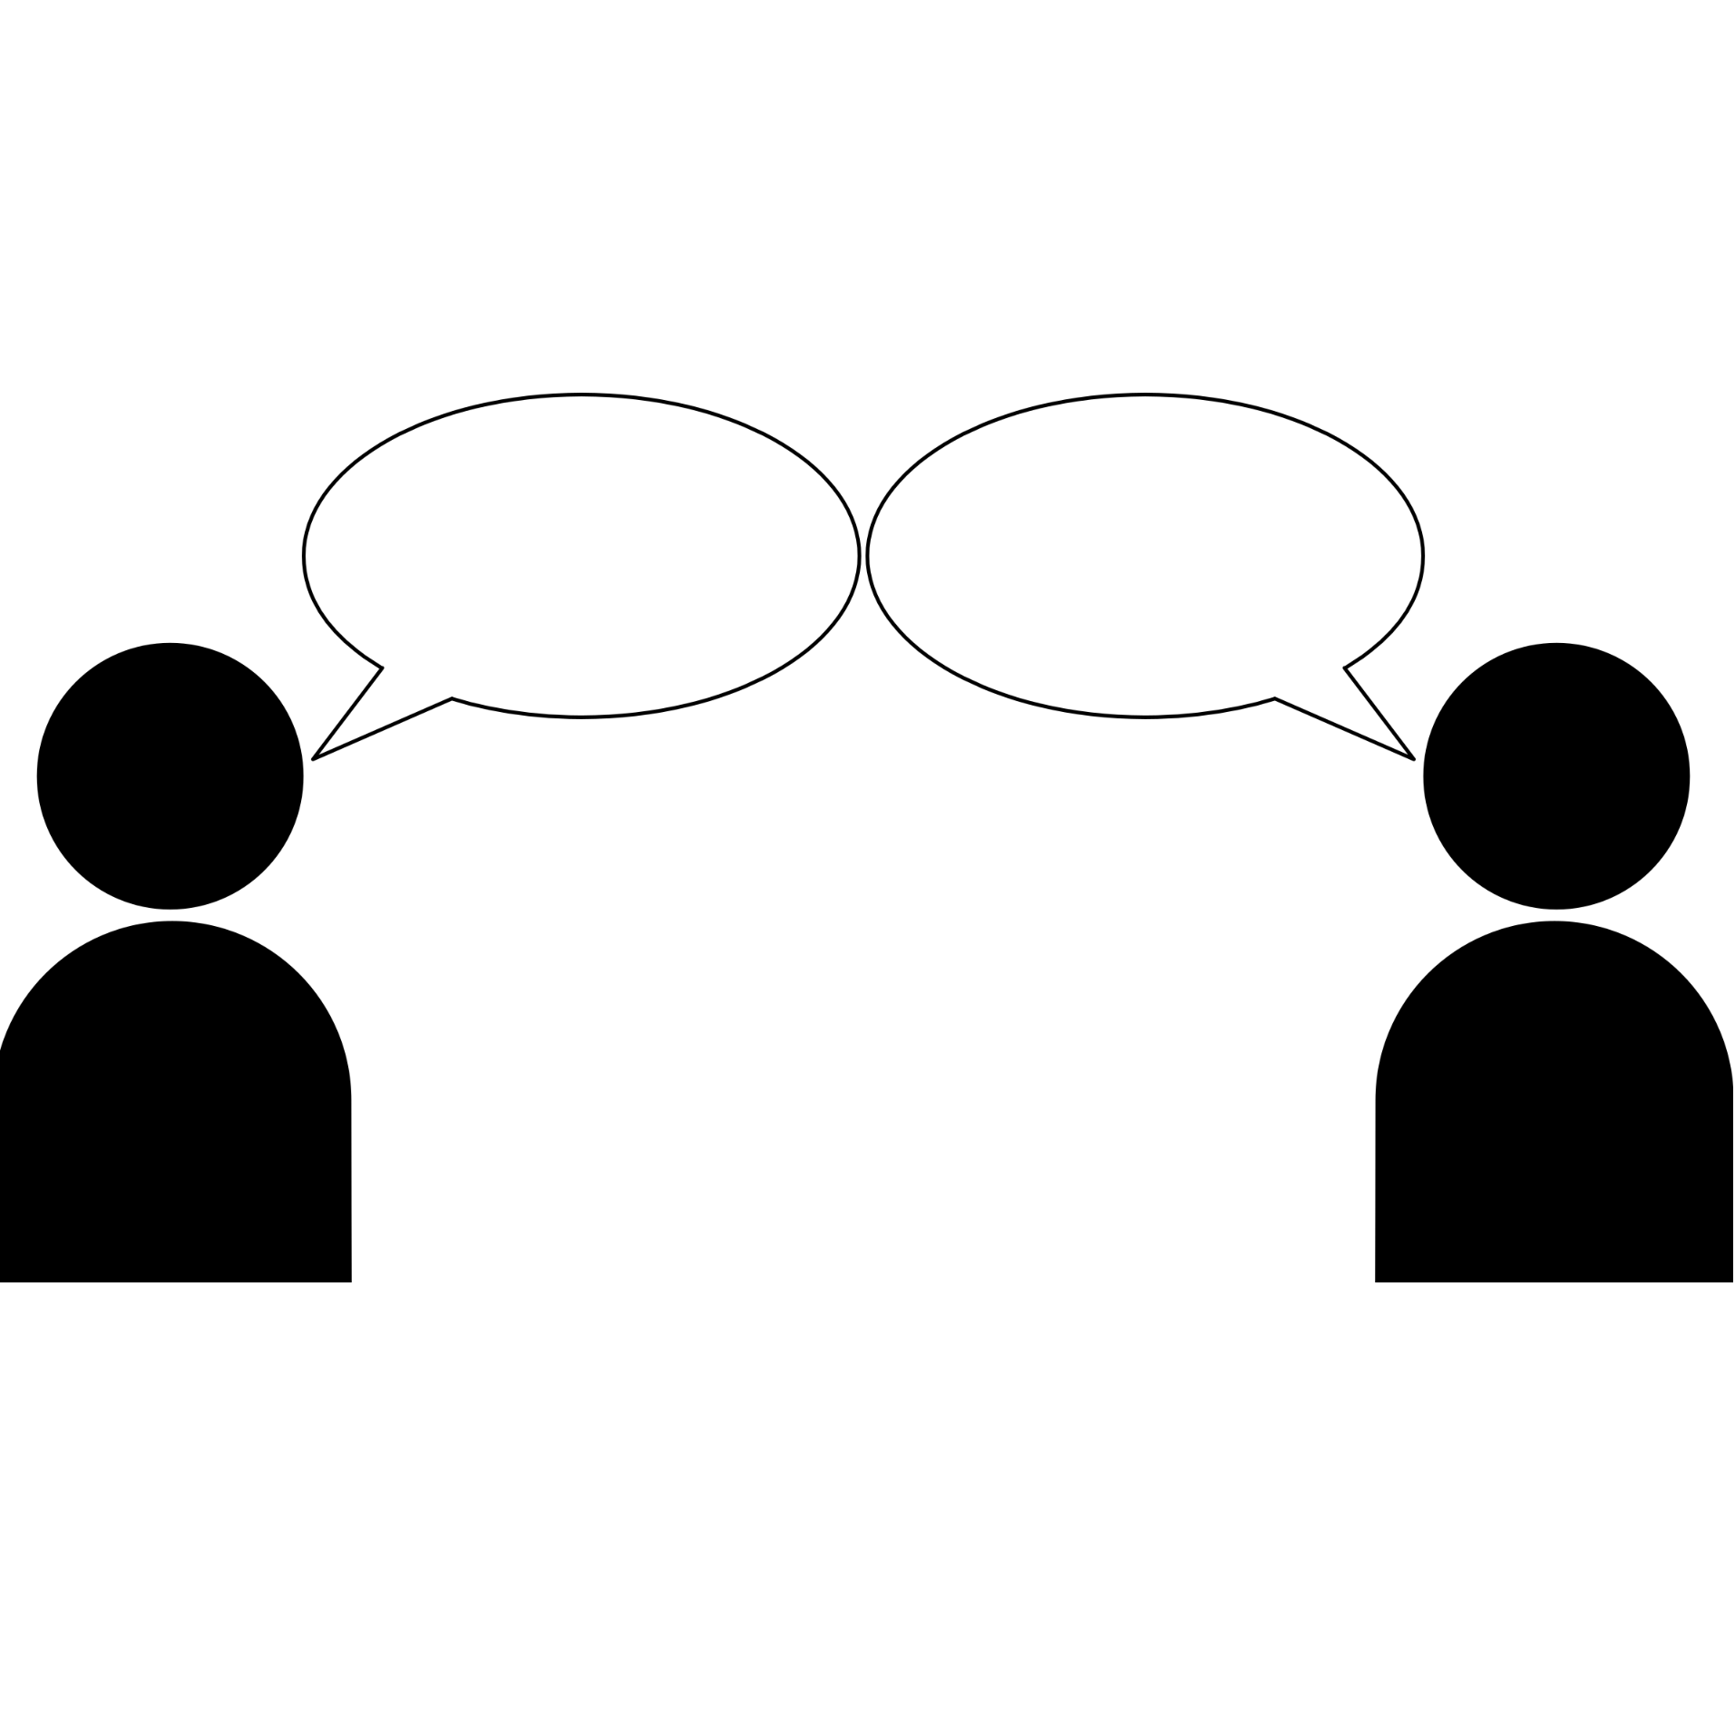
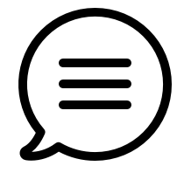



Moving towards NLU, via QA
Natural Language Understanding:
Interpret a given text similar to humans.
Measuring the progress by answering questions.
A system that is better in understanding language, should have a higher chance of answering these questions.
This has been used in the field for many years
Question Answering,
Reading Comprehension,
Machine Comprehension, etc.
[Winograd, 1972; McCarthy 1976; Lehnert, 1977b; others]
Notes:
Let's start with the foundations.
What are we aiming to achieve as a community?
A core target here is NLU, which is enabling machines to read and understand natural language, just like humans.
Since this goal is abstract, as a field, we have come up with different protocols to measure our progress;
a protocol we’re focusing on is measuring NLU through answering natural language questions:
if an actor (human or computer) understands a given text, it should have a higher chance of answering questions about it.
We (community) have given different names to this protocol; question answering, machine comprehension, etc. Each of these names seem to imply certain assumptions about the tasks at hand.
Just so that we have a working definition here, I am going to define it myself here.

Slide 3
QA; a broad definition
Task: Question Answering (QA)
“What does photosynthesis produce that helps plants grow?”
“sugar”
Input: A question, along with additional information (hints, docs, images, etc.)
Output: a string that addresses the input question.
Notes:
For the sake of this presentation, I am using a broad definition for the task of QA here:
The input of our task is a question, with a bunch of supplementary information (like documents, hints, etc.) and the expected output is another string that addresses the input question.
As I mentioned, it’s a pretty broad definition:
It does not specify what kind of questions,
It does not specify what additional information is supplemented
It does not say how the answer should look like.

Slide 4
QA datasets
…
…
OBQA
BoolQ
Motivations for publishing new datasets:
Unexplored reasoning challenges
Alternate (better?) evaluation protocol (expand)
NarQA
DROP
SQuAD1
SQuAD 2
ComQA
…
TREC-8
TREC-9
TREC-2001-2005.
MCTest
RACE
ARC
WinoGrande
2000 2005 2010 2015 2020
Notes:
Now, when we look at the QA datasets published in the past two decades, (here is a list)
Evidently we’re building many datasets. Many more than what I am showing here.
But we do we publish datasets?
My understanding is that any new dataset offers at least one of the followings: ….
And these two are not necessarily independent from each other; i.e., an evaluation protocol might suite only a certain types of reasoning challenges.

Slide 5
QA datasets
…
OBQA
BoolQ
NarQA
DROP
SQuAD1
SQuAD 2
ComQA
…
TREC-8
TREC-9
TREC-2001-2005.
MCTest
RACE
ARC
WinoGrande
2000 2005 2010 2015 2020
Question: “At what speed did the turbine operate?”
“16,000 rpm”
Candidates: (Nikola_Tesla) On his 50th birthday in 1906, Tesla demonstrated his 200 horsepower (150 kilowatts) 16,000 rpm bladeless turbine. ...
[Rajpurkar et al, 2016]
Notes:
For example, the SQuAD dataset popularized the extractive format, where each question question comes with accompanying paragraph is supposed to contain explicitly contain the answer to the question.
(read the question) .. The answer is this number which can be extracted from the paragraph.

Slide 6
QA datasets
…
OBQA
BoolQ
NarQA
DROP
SQuAD1
SQuAD 2
ComQA
…
TREC-8
TREC-9
TREC-2001-2005.
MCTest
RACE
ARC
WinoGrande
2000 2005 2010 2015 2020
Question: “What does photosynthesis produce that helps plants grow? ”
“The big kid”
Candidates: (A) water (B) oxygen (C) protein (D) sugar
[Clark et al, 2018]
Notes:
Similarly, multiple-choice questions should be a a familiar variant of QA for us;
A question is supplemented with a bunch of candidate answers
And the expected output is exactly one of the candidate answers.

Slide 7
QA Terminology
“Task”: well-formed response for a well-formed question.
“Format”: QA with particular assumptions about input/output.
Defined by datasets.
A necessity for automatic evaluation.
Depends on the reasoning problem, too.
Input: well-formed question
Output: a well-formed response
Format | Example dataset
Multiple-choice | CommonsenseQA [Talmor et al’19]
YesNo | BoolQ [Clark et al’19]
extractive | SQuAD [Rajpurkar et al’16]
abstractive | NarrativeQA [Kociský et al’18]
Notes:
Now that I have told you about the task and our setting, let me be explicit about several key terms I am using throughout, just to make sure we’re clear about the terminology.
As I defined earlier, I consider QA a task; (read)
Format (or, version, setting) is a variant of QA with a set of assumptions made about input and output.
- For example, commonsenseqa is defined in terms of multiple-choice format, a particular variant of QA; or BoolQ is another dataset with YesNo format, and so on.
- Format is something that is defined by datasets.
- And it is often a necessity for efficient evaluation of the given reasoning problem. For example, Commonsenseqa being a multiple-choice format makes it easy to evaluated it automatically.
- certain reasoning task are more convenient to be evaluated as a certain format; e.g., it might not make much sense to formulate commonsenseqa dataset as an extractive format.
With the terminology defined, let’s talk about the progress of the field.

Slide 8
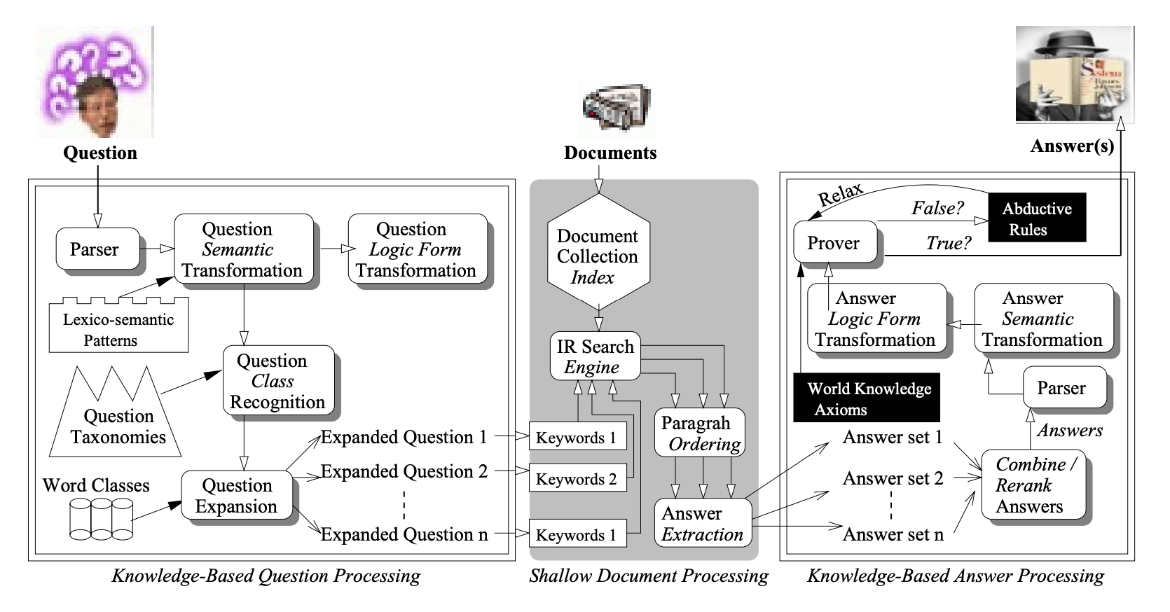
Our progress in QA: the good
More general language representations.
[Harabagiu et al, 2000; others]
Input
Task-specific layer
[Peters et al; Devlin et al; others]
Notes:
With respect to our progress in the field, one point that many of us would probably agree is the generality of the representation techniques today.
On the right you see a picture from QA paper of 20 years ago. You can see sorts of specialized models (parser, question type recognizer, world knowledge axioms, etc) that they had to use internally to build a representation for their QA model.
Now all that you have to do is to download your favorite muppet, feed it the input, and devise a task-specific output for it.

Slide 9
Our progress in QA: the bad
Consequences of format-specific design:
Prevent generalization across formats
Don’t benefit from labeled data of other formats.
Input
Task-specific layer
format | assumption
Yes/No QA
Multiple-choice QA
Extractive QA
Abstractive QA
binary output
exactly one of the candidate answers is correct.
answer is a subset of a given paragraph
answer is a mixture of what is given and items not given.
Task-specific assumptions
Notes:
When it comes to negatives aspects of our progress, there is a lot to talk about.
The issue that is more relevant to our focus here is about the design assumptions that we include in our QA models, often in their last layers.
Somehow our field, has accepted that it is okay to encode format-specific assumptions of datasets.
For example: people who solve yes/no datasets (read)
We (the community) frequently exploit some of these assumptions that move them away from the broad definition QA.
And there are consequence to such designs;
A format-specific assumptions create hard barriers for generalization of the systems across formats.
A system engineered for YN cannot run on SQuAD questions.
There is also a missed opportunity here; as I will show later, QA systems trained with seemingly different formats could benefit each other.

Slide 10
formats-specialized models
ExtractiveQA
Question: “At what speed did the turbine operate?”
(Nikola_Tesla) On his 50th birthday in 1906, Tesla demonstrated his 200 horsepower (150 kilowatts) 16,000 rpm bladeless turbine. …
“16,000 rpm”
MultipleChoiceQA
Question: “What does photosynthesis produce that helps plants grow?”
(A) water (B) oxygen (C) protein (D) sugar
“sugar”
Notes:
Just to say they say the same thing with a bit more graphics:
in our field is that, within the boundaries define by each of the QA formats, we have seen lots of activities. There are many format-specialized models, and this even has result in implicit division in the QA community.
We argue that such boundaries are artificial and perhaps unnecessary, given there is a lot of sharedness among the reasoning abilities we seek to teach to models. ("tear down that wall")

Slide 11
Beyond formats-specialized models
ExtractiveQA
Question: “At what speed did the turbine operate?”
(Nikola_Tesla) On his 50th birthday in 1906, Tesla demonstrated his 200 horsepower (150 kilowatts) 16,000 rpm bladeless turbine. …
“16,000 rpm”
MultipleChoiceQA
Question: “What does photosynthesis produce that helps plants grow?”
(A) water (B) oxygen (C) protein (D) sugar
“sugar”
Notes:
We building a system, UnifiedQA, that performs surprisingly well across four different QA formats.

Slide 12
Talk Summary & Statement
Creating format-specific QA models distance us from broad QA.
There is overlap between underlying reasoning abilities of formats.
One can benefit from mixing QA formats.
UnifiedQA: a single QA system working across four common QA formats.
Fine-tuning models pre-trained on UnifiedQA yields SOTA results.
Notes:
- …hence, it is discouraged.
- The good news is that: there is …. [seemingly different]. …
since the reasoning is shared among formats, one can benefit from mixing different QA formats.
- We build based on these intuitions to create a model

Slide 13
Earlier work on multi-task learning
In the same spirit as multi-task learning.
The choice of tasks is also important.
Earlier works select too broad of tasks.
E.g., Raffel et al’19 diverse NLP tasks (machine translation, summarization, etc) and conclude that a single model for multiple NLP tasks underperform task-specific models.
We narrow the scope of tasks to stay within the boundaries of QA.
No task/format specific encoding.
[Caruana'97; McCann et al’18]
Didn’t work before; why would it work now? 🤔
Notes:
Exploiting commonality across tasks has extensively been explored extensively, often under transfer learning or mullti-task learning.
My understanding is that the majority of the effort put in multi-task learning don't end in any meaningful results.
Here you might say, well it seems like you're also doing multi-task learning; it didn't for others, why do you expect it to work for you?
In most cases, I'd argue, the failure of a multi-task learning (or their success, for that matter) should not be blamed on the algorithms, but rather on the choices of the tasks.
Many works, often select a broad set of tasks.
Raffel et al. (2019) diverse NLP tasks (machine translation, summarization, etc).
what they observe is that building a single model for multiple NLP tasks underperform the standard pre-training plus finetuning setup (a model per task).
Besides, they rely on textual prefixes to explicitly define the task corresponding to each input instance.
We narrow down the scope to tasks that stay within the boundaries of QA, and show that transfer across different QA variants is indeed possible.
This also allows avoiding any format-specific encoding -- such as prefixes, etc.
In other words, our models are expected to learn to infer the format of each input question based on its content (e.g., whether the phrasing of the question demands a yes/no answer).

Slide 14
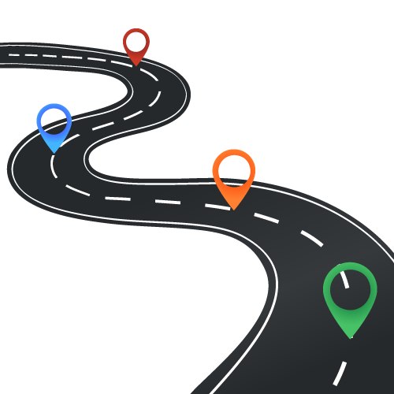
Roadmap
Generalization across formats
UnifiedQA + Empirical Intuitions
Discussion and next steps
Notes:
Here is a rough roadmap:
- I am going to discuss the value in mixing pairs of QA formats. =
- I am going to define what is UnifiedQA, then show some empirical intuitions and then end with some discussion of future works.
- I will end with a short discussion and future work.

Slide 15
Roadmap
Generalization across formats
UnifiedQA + Empirical Intuitions
Discussion and next steps

Slide 16
UnifiedQA: a high-level definition
It’s a single system that is supposed to work on a variety of QA formats.
The input should be natural.
Minimal-enough for a human solver to infer the format.
“What causes sound?
(A) sunlight (B) vibrations (C) x-rays (D) pitch”
“vibrations”
Notes:
Let’s start with the high-level definition of the system I have in mind.
- (read)
- (read) humans should be able to infer the format by just reading the input.
what does it mean; let's see an example.
Suppose I give you think prompt (the content of this little box here) to you and ask you to answer it. What would you say?
....
Note, humans don't need to be told that this is a multiple-choice question. You just read it and infer it. And that's what expect a system to be able to do as well.

Slide 17
UnifiedQA: a high-level definition
It’s a single system that is supposed to work on a variety of QA formats.
The input should be natural.
Minimal-enough for a human solver to infer the format.
“Is Jamaica considered part of the United States?
(Jamaica) Jamaica (/dʒəˈmeɪkə/ ( listen)) is an island country situated in the Caribbean Sea. Spanning 10,990 square kilometres (4,240 sq mi) in area, it is the third-largest island of the Greater Antilles and the fourth-largest island country in the Caribbean.”
“no”
Notes:
Here is another example,
(read it)
again, humans don't need to be told that it is yes/no. They can infer it from the input.

Slide 18
UnifiedQA: a high-level definition
It’s a single system that is supposed to work on a variety of QA formats.
The input should be natural.
Minimal-enough for a human solver to infer the format.
The question always comes first.
Additional info are appended with “\n”.
“What type of musical instruments did the Yuan bring to China?
(Yuan_dynasty) Western musical instruments were introduced to enrich Chinese performing arts. From this period dates the conversion to Islam, by Muslims of Central Asia, of growing numbers of Chinese in the northwest and southwest. ...”
“Western musical instruments”
Notes:
Here is another one:
(read)
Again you don't need to know what is the format or the dataset. You just read and use what is given to you to generate a response.
Overall, all these examples that I showed you basically define how we encode our questions.
- (read)
Again, the encoding never explicitly mentions what is the format of a given dataset or what dataset it belongs to.

Slide 19
UnifiedQA: towards an implementation
Use text-to-text architectures
T5 [Raffal et al, 2020], BART [Lewis et al, 2019], etc.
Train simultaneously on all datasets jointly together.
Batches contains the same number of instances from each training set.
Notes:
The key technical requisite that we’re borrowing from the field is text-to-text architectures, such as T5, BART
When training on multiple datasets, we use them simultaneously (as opposed to sequentially).
- To make sure the model is uniformly exposed to all the datasets, we form batches that are expected to contains the same number of instances from each training set, regardless of its size (sampling probability == inversely proportional to the size of the training data).

Slide 20
Mixing pairs of formats: experiment (1)
Is there any value in out-of-format training?
70
65
60
55
50
Mixing RACE (Multiple-Choice) w/ datasets of different formats.
69.4
62.5
59.1
Trained on RACE
55.8
Trained on RACE + SQuAD 1
RACE
MCTest
[Lai et al. 17]
[Richardson et al. 15]
Notes:
To study of our initial hypothesis, what we do is to mix pairs of datasets and see whether their is any gain in mixing them.
(read content of this page).
I don’t know about you, but when I was seeing these improvements, I was thinking to myself that I must have a bug somewhere.
Like how can you gain so much by creating these odd combinations.

Slide 21
Mixing pairs of formats: experiment (2)
Is there any value in out-of-format training?
Mixing BoolQ (YesNo) w/ datasets of different formats.
80
70
60
50
X=SQuAD 1 (Extractive)
78.9
76.4
X=SQuAD 1 (Extractive)
66.0
X=NarQA (Abstractive)
64.1
Trained on BoolQ
61.0
53.4
Trained on BoolQ + X
BoolQ
BoolQ-CS
MultiRC (YN subset)
[Clark et al. 19] [Gardner et al. 20] [K et al. 18]
Notes:
And you don't really need anything super-smart here.
You just mix them and they seem to work.
We have empirically showed that there are pairs of datasets with different formats that benefit from each other.
Brings us to the question of what happens when you mix multiple datasets?
####After this we should have a quick summary.

Slide 22
Roadmap
Generalization across formats
UnifiedQA + Empirical Intuitions
Discussion and next steps

Slide 23
Roadmap
Generalization across formats
UnifiedQA + Empirical Intuitions
Discussion and next steps

Slide 24
UnifiedQA-v1
Trained on the union of different formats:
Extractive: SQuAD 1.1, SQuAD 2.0
Abstractive: NarrativeQA
Multiple-choice: RACE, ARC, OBQA, MCTest
YesNo: BoolQ
Architectures:
T5 (11B, 3B, …)
BART (large)
https://github.com/allenai/unifiedqa

Slide 25
Intuition #1: Comparison w/ Dedicated Models
Is UnifiedQA as good as systems dedicated to individual datasets?
UnifiedQA performs almost as good as individual T5 models targeted to each dataset.
evaluation sets
 | SQuAD2 | RACE | BoolQ | NarQA
T5 (SQuAD 2) | 91 | 33 | 12 | 51
T5 (RACE) | 43 | 87 | 7 | 54
T5 (BoolQ) | 4 | 22 | 90 | 0
T5 (NarQA) | 45 | 48 | 47 | 65
UnifiedQA | 90 | 87 | 90 | 65
Notes:
Is UQA as good as dedicated systems trained for individual datasets?
- The BLUE bars belong to UQA (a single system for multiple datasets of different formats).
- The GREEN bars are dataset-specific models; i.e, each bar belongs to each dataset.
The results show that UQA performs almost as good as individual T5 models targeted to each dataset. In some cases UQA performs even better than the single-dataset experts (e.g., on OBQA or NQA).
On average (the bars on the right side) UQA clearly outperforms the ensemble of dataset/format-specific systems.
(show the table)
Here is the subset of the same results in a tabular format.
- each row is a system.
- first few rows are dataset-specific systems.
- And the last row shows UQA.
- You can see that dataset-specific models are good, however, they don't generalize to other formats.
UQA thus offers flexibility across multiple QA formats while compromising almost nothing compared to dataset-specific experts.

Slide 26
Intuition #2: Unseen Datasets
Does UnifiedQA generalizes well to unseen datasets?
On average, UnifiedQA shows much stronger generalization across a wide range of datasets.
evaluation sets
 | NewsQA | Quoref | DROP | DROP-CS | QASC | CommonsenseQA | NP-BoolQ | BoolQ-CS | Avg
UnifiedQA [EX] | 59 | 65 | 25 | 24 | 55 | 63 | 21 | 13 | 42
UnifiedQA [AB] | 58 | 68 | 31 | 37 | 54 | 59 | 27 | 40 | 48
UnifiedQA [MC] | 48 | 68 | 29 | 37 | 68 | 76 | 3 | 6 | 44
UnifiedQA [YN] | 1 | 2 | 0 | 0 | 15 | 21 | 79 | 79 | 22
UnifiedQA | 59 | 63 | 33 | 40 | 68 | 76 | 81 | 80 | 62
models trained for individual formats
Notes:
We now explore whether UQA generalizes well to other, *unseen* datasets. Here is a table that summarizes the results of experiments where we evaluate various models on datasets that are not observed during training.
Each row is a model.
The first few rows shows T5 models trained for individual formats; (e.g., UQA [EX], built by training the model on only extractive datasets).
The last rows shows UQA (training on multiple formats)
Several observations here:
Single-format experts are better at generalization only when the source and target datasets are very similar (for instance SQuAD and Quoref)
Meanwhile, they do not generalize to unseen datasets of unseen formats;
which kinds of expected, but it goes to show the the importance of feeding a diverse questions, if you want it to function on broad QA.
Overall UnifiedQA shows a pretty generalization compared to the single-format models.
In several cases in fact, UQA shows a better generalization than single-format experts; e.g., DROP.
A point to highlight is that UnifiedQA is trained on multiple-choice questions with 4 candidate answers.
That being said, it works quite well on datasets with more than 4 candidate answers (QASC and CommonsenseQA have has 8 and 5 candidate answers per question, respectively).
On average (last column), UNIFIEDQA shows much stronger generalization across a wide range of datasets.

Slide 27
Fine-tuning on UnifiedQA
Is there a value in using UnifiedQA as a starting point for fine-tuning?
Show SOTA on 10 datasets (OBQA, QASC, RACE, WinoGrande, PIQA, SIQA, ROPES)
Similar trends for BART
85
75
65
87
84
78
79
Fine-tuned on T5
78
70
Fine-tuned UnifiedQA (based on T5)
ARC-chall
CommonsenseQA
OBQA
[Clark et al. 18] [Talmor et al. 19] [Khot et al. 19]
Notes:
Fine-tuning of pre-trained language models has become the standard paradigm for building datasetspecific stat-of-the-art systems. The question we address here is: when it comes to QA, is there a value in using UQA as a starting point for fine-tuning, as opposed to a vanilla language model that has not seen other QA datasets before?
Here I am showing the results of fine-tine two systems.
We see that fine-tuning on UQA consistently dominates fine-tuning on T5, respectively.
Intuitively, since UQA has seen different formats, it should be positioned to achieve higher scores after a little fine-tuning, compared to fine-tuning on a vanilla T5 model.
This is especially effective when a user has limited training data for a target QA task
We have an extensive table on this if you look at our paper, where we should report SOTA numbers on 10 datasets by fine-tuning on UnifiedQA.
We show these results not just for T5, but also BART which is another text-to-text architecture. This also highlights that the effectiveness of crossformat training is not limited only to T5, but is rather a general trend for text-to-text architectures.

Slide 28
Demo
https://unifiedqa.apps.allenai.org

Slide 29
Roadmap
Generalization across formats
UnifiedQA + Empirical Intuitions
Discussion and next steps

Slide 30
Roadmap
Generalization across formats
UnifiedQA + Empirical Intuitions
Discussion and next steps

Slide 31
Methodological Issue: Data Leakage
“have you done some studies on overlap across datasets?”
Easy answer:
not much surface-form overlap between the datasets.
Nuanced/ difficult answer:
more data (especially during pre-training) increases the chances of (indirect) leakage.
Notes:
I wanna address a common question that I get these days here;
And that is: (read)
This is a simple question, but surprisingly a tricky one to answer.
If we want to be a bit simplistic, here is the easy answer: On the surface level, there is not much overlap between the datasets, and hence there is no leakage. There is something really unsatisfactory about this answer …
Here is the correct (but the tricky) one: with more more (supervised on unsupervised) observations, the chances of leakage increases.
And this issue is not just particular to UnifiedQA;
Our models have already seen the answers to many of the questions somewhere on the internet, mostly during pre-training.
But the issue is: will the LM or UnifiedQA of today, work on questions of tomorrow; questions that we don’t necessarily know today.
I don't know how to go about studying myself, but I encourage everyone to think about it; we (as a community) need to better methodologies for evaluation of our real progress.

Slide 32
Where do we go from here?
More formats
Can we incorporate other “natural” variations of QA in the study?
Smaller models:
Can we build small and accurate models to make it more available?
Beyond QA/Text:
Can you take these ideas and apply it to some other problems?
Notes:
As immediate follow ups, there are several immediate angles we’re persuing:
More QA formats (Open-domain QA): Can we add more "natural" formats of QA, such as questions-only inputs (like AmbigQA/NQ-open)?
Smaller models (Distilling UnifiedQA): We had success in huge models, but that's not so accessible for the majority of the field. Can we make our contributions more accessible by turning them into much smaller and faster models?
TODO: how can you take these ideas and apply it to some other problems, possibly beyond QA and beyond just text.

Slide 33
Take-home points
The field relies excessively format-specific assumptions for system design.
Instead, we should move towards more general QA architectures.
Incentive: there is value in mixing QA datasets of different formats.
UnifiedQA, a single pre-trained QA system seeking to bring unification across common QA formats.
https://github.com/allenai/unifiedqa
Notes:
- ....
- ....
- .... Somewhere I have to say: it is fine to use format-specific assumptions of evaluation. It is not fine to use format-specific design assumptions.

Slide 34
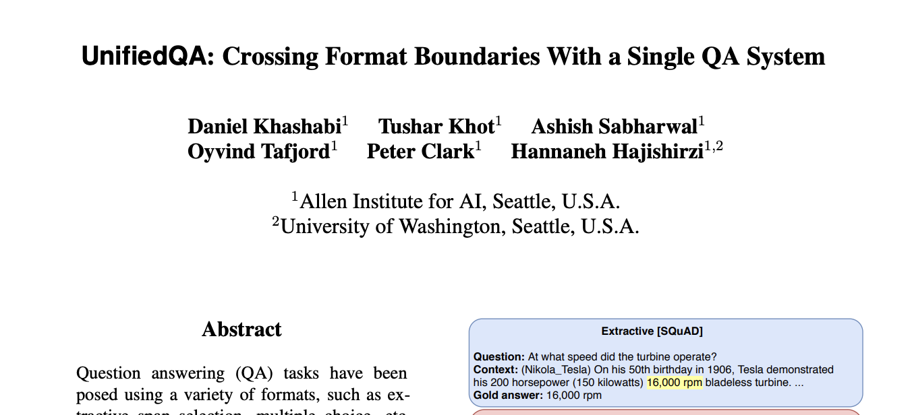
Reading more
Paper on Arxiv
Notes:
If you’re interested in reading more on this, we have a draft online.
It’s semi outdated.
However, I will share the latest version of the work, after this demo, along with the link to the demo.
Thank you!

Slide 35
QA datasets
…
OBQA
BoolQ
NarQA
DROP
SQuAD1
SQuAD 2.0
ComQA
…
TREC-8
TREC-9
TREC-2001-2005.
MCTest
RACE
ARC
WinoGrande
2000 2005 2010 2015 2020
Question: “Who was Billy?”
Passage: “Billy was like a king on the school yard. A king without a queen. He was the biggest kid in our grade, so he made all the rules during recess. ... Candidates: (A) The skinny kid (B) A teacher (C) A little kid (D) The big kid
“The big kid”
Notes:
Here is another format you’re familiar with: multiple-choice QA, where the question comes with a bunch of candidates.
(read the question) and the expected answer is one of these candidate answers.

Slide 36
QA datasets
…
OBQA
BoolQ
NarQA
DROP
SQuAD1
SQuAD 2.0
ComQA
…
TREC-8
TREC-9
TREC-2001-2005.
MCTest
RACE
ARC
WinoGrande
2000 2005 2010 2015 2020
Question: “What does a drink from narcissus's spring cause the drinker to do?”
“fall in love with themselves ”
Candidates: Mercury has awakened Echo, who weeps for Narcissus, and states that a drink from Narcissus's spring causes the drinkers to ``Grow dotingly enamored of themselves.'' ...

Slide 37
QA datasets
…
OBQA
BoolQ
NarQA
DROP
SQuAD1
SQuAD 2.0
ComQA
…
TREC-8
TREC-9
TREC-2001-2005.
MCTest
RACE
ARC
WinoGrande
2000 2005 2010 2015 2020
Question: “At what speed did the turbine operate?”
“16,000 rpm”
Candidates: (Nikola_Tesla) On his 50th birthday in 1906, Tesla demonstrated his 200 horsepower (150 kilowatts) 16,000 rpm bladeless turbine. ...

Slide 38
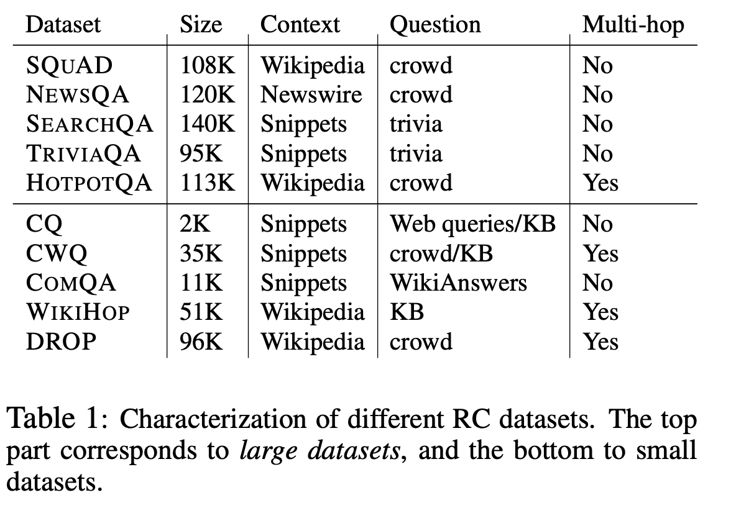
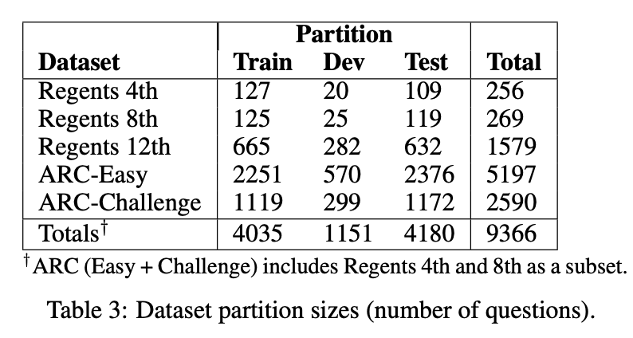
Silos of QA community
Works studying QA generalization are limited to formats.
[“MultiQA : … “, Talmor & Berant, 2019]
[“From ‘F’ to ‘A’ … “, Clark et al, 2019]
Extractive datasets
Multiple-choice datasets
Notes:
The result is that

Slide 39
UnifiedQA: towards an implementation
Use text-to-text architectures
T5 [Raffal et al, 2020], BART [Lewis et al, 2019], etc.
Encoding:
Input: Any question (of any format) is encoded as raw text.
Output: a string
Substring of a paragraph, yes/no, one of the candidate answers, etc.
Notes:
The key technical requisite that we’re borrowing from the field is text-to-text architectures, such as T5, BART
To accommodate the conditions I
How would you go about creating this encoding

Slide 40
Formats-specialized models
ExtractiveQA
Question: “At what speed did the turbine operate?”
(Nikola_Tesla) On his 50th birthday in 1906, Tesla demonstrated his 200 horsepower (150 kilowatts) 16,000 rpm bladeless turbine. …
“16,000 rpm”
MultipleChoiceQA
Question: “What does photosynthesis produce that helps plants grow?”
(A) water (B) oxygen (C) protein (D) sugar
“sugar”

Slide 41
UnifiedQA: input-output encoding
The input should be minimal.
Minimal-enough for a human solver to infer the format.
Rules:
The question always comes first.
Any additional information is supplied next, each separated with “\n”.

Slide 42
Input-output encoding: examples
MultipleChoiceQA
Question: “What does photosynthesis produce that helps plants grow?”
(A) water (B) oxygen (C) protein (D) sugar
“sugar”
“What does photosynthesis produce that helps plants grow? \n
(A) water (B) oxygen (C) protein (D) sugar”
“sugar”

Slide 43
Input-output encoding: examples
ExtractiveQA
Question: “At what speed did the turbine operate?”
(Nikola_Tesla) On his 50th birthday in 1906, Tesla demonstrated his 200 horsepower (150 kilowatts) 16,000 rpm bladeless turbine. …
“16,000 rpm”
“At what speed did the turbine operate? \n
(Nikola_Tesla) On his 50th birthday in 1906, Tesla demonstrated his 200 horsepower (150 kilowatts) 16,000 rpm bladeless turbine. ... ?”
“16,000 rpm”

Slide 44
Input-output encoding: examples
YesNoQA
Question: “Was America the first country to have a president?
(President) The first usage of the word president to denote the highest official in a government was during the Commonwealth of England ...
“no”
“Was America the first country to have a president? \n
(President) The first usage of the word president to denote the highest official in a government was during the Commonwealth of England ...”
“no”

Slide 45
Proof of concept: mixing pairs of formats
Is there any value in out-of-format training?
Setting:
I want to evaluate my system on all datasets of format A (e.g., A=ExtractiveQA).
Can I gain anything by tra
Do we gain anything from training on combination of datasets of
Notes:
We first answer the question: Is the broad idea of benefiting from out-of-format training even viable?
For instance, is our intuition correct that an MC dataset can, in practice, benefit from training on an EX dataset?

Slide 46
Mini-summary
TODO
We have empirically showed that there are pairs of datasets with different formats that benefit from each other.
What about mixing more datasets?
Notes:
Brings us to the question of what happens when you mix multiple datasets?

Slide 47
Fine-tuning on UnifiedQA
Is there a value in using UnifiedQA as a starting point for fine-tuning?
65
55
45
35
70
66
64
63
55
Fine-tuned on BART
40
Fine-tuned UnifiedQA (based on BART)
OBQA
ARC-chall
CommonsenseQA
[Khot et al. 19] [Clark et al. 18] [Talmor et al. 19]
Notes:
Fine-tuning of pre-trained language models has become the standard paradigm for building datasetspecific stat-of-the-art systems. The question we address here is: when it comes to QA, is there a value in using UNIFIEDQA as a starting point for fine-tuning, as opposed to a vanilla language model that has not seen other QA datasets before?
Here I am showing the results of fine-tine two systems.
We see that fine-tuning on UNIFIEDQA consistently dominates fine-tuning on T5 and BART, respectively.
It also dominates the best previous scores on the datasets. Intuitively, since UNIFIEDQA has seen different formats, it should be positioned to achieve higher scores after a little fine-tuning, compared to fine-tuning on a vanilla T5 or BART model.
This could be especially effective when a user has limited training data for a target QA task This also highlights that the effectiveness of crossformat training is not limited only to T5, but is rather a general trend for text-to-text architectures.

Slide 48
Fine-tuning on UnifiedQA
Notes:
Fine-tuning of pre-trained language models has become the standard paradigm for building datasetspecific stat-of-the-art systems (Devlin et al., 2019; Liu et al., 2019). The question we address here is: when it comes to QA, is there a value in using UNIFIEDQA as a starting point for fine-tuning, as opposed to a vanilla language model that has not seen other QA datasets before?
To address question, we fine-tune each of UNIFIEDQA, T5, and BART on several datasets by selecting the best check point on the dev set, and evaluating on the test set. The columns indicate the evaluation on the test set corresponding to the data that was used for training. with “w/ IR” tags. We use the same IR sentences as used by the baselines We see that fine-tuning on UNIFIEDQA consistently dominates fine-tuning on T5 and BART, respectively. It also dominates the best previous scores on the datasets. Intuitively, since UNIFIEDQA has seen different formats, it should be positioned to achieve higher scores after a little fine-tuning, compared to fine-tuning on a vanilla T5 or BART model. This could be especially effective when a user has limited training data for a target QA task (also shown in Appendix A.6.) This also highlights that the effectiveness of crossformat training is not limited only to T5, but is rather a general trend for text-to-text architectures.

Slide 49
Fine-tuning on UnifiedQA
TODO
Notes:
Fine-tuning of pre-trained language models has become the standard paradigm for building datasetspecific stat-of-the-art systems (Devlin et al., 2019; Liu et al., 2019). The question we address here is: when it comes to QA, is there a value in using UNIFIEDQA as a starting point for fine-tuning, as opposed to a vanilla language model that has not seen other QA datasets before?
To address question, we fine-tune each of UNIFIEDQA, T5, and BART on several datasets by selecting the best check point on the dev set, and evaluating on the test set. The columns indicate the evaluation on the test set corresponding to the data that was used for training. with “w/ IR” tags. We use the same IR sentences as used by the baselines We see that fine-tuning on UNIFIEDQA consistently dominates fine-tuning on T5 and BART, respectively. It also dominates the best previous scores on the datasets. Intuitively, since UNIFIEDQA has seen different formats, it should be positioned to achieve higher scores after a little fine-tuning, compared to fine-tuning on a vanilla T5 or BART model. This could be especially effective when a user has limited training data for a target QA task (also shown in Appendix A.6.) This also highlights that the effectiveness of crossformat training is not limited only to T5, but is rather a general trend for text-to-text architectures.

